Slide 1
The Swift River Valley:
The People in Their Environment
Emma, Jessica, Katie, and Rose
2nd Grade

Slide 2
Learning Objectives:
I can understand how people use their environment to meet their needs.
I can write down what a picture makes me think, feel, and I can share it with my classmates.
I can understand that symbols used in maps stand for parts of the environment.
I can read symbols on a map to understand what the landscape looks like.

Slide 3
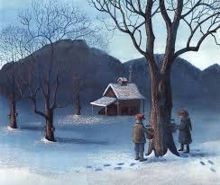
Illustration by
Barbara
Cooney from
Letting Swift River Go (1995)

Slide 4
Activity 1: Respond to the picture
Activity 2: Turn and Talk share your thoughts on your responses to your neighbor, Exchange note catcher. Talk for one minute each person.

Slide 5
Mapping:
What do you know about maps?
Let’s take a look at a map of the Quabbin:
https://www.google.com/maps
What do you notice on the map?

Slide 6
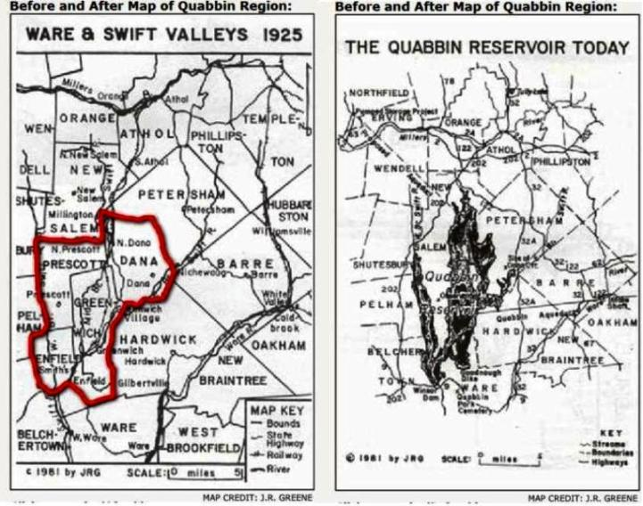
Source:
www.stampcommunity.org

Slide 7
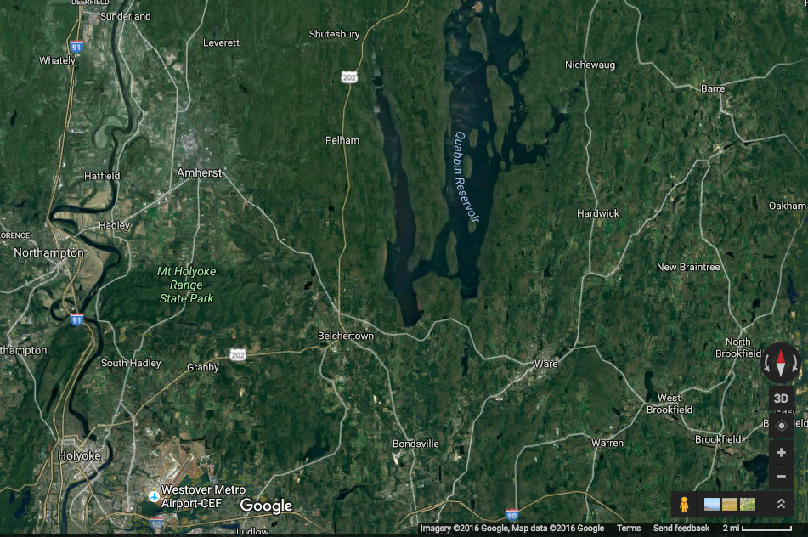
Source: Google Maps

Slide 8
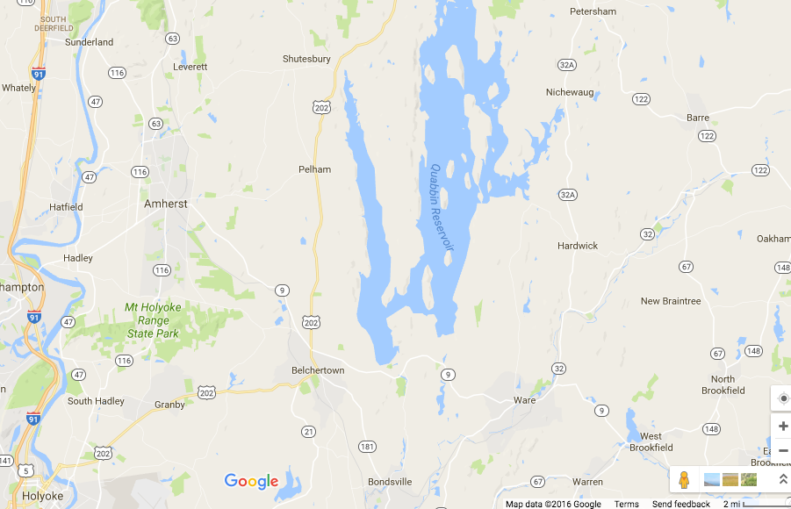
Source:
Google
Maps

Slide 9
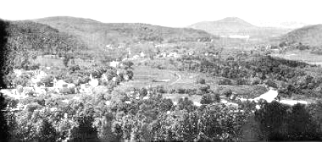
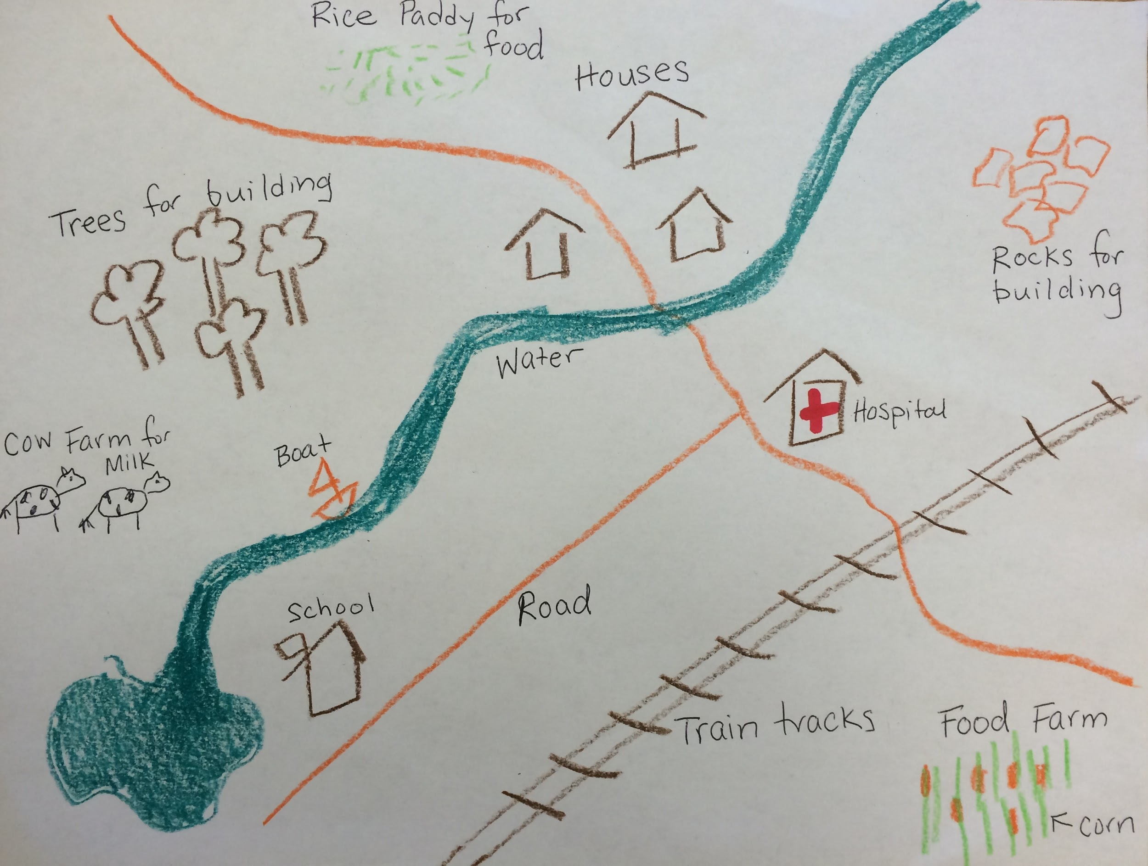
Assessment:
Create a make-believe new home for Swift River Valley residents.
Draw or design with the picture tiles, a map of a new town.
Include things they would need in order to survive.
Example of map by Rose
Notes:
Second grade students will be able to refer to the rubric for specific directions of what to include in their map.

Slide 10
Part of map: | I get it | I’m not sure | I’m still thinking
Water | The water is near to and big enough for everyone to use | The water is too far away or too small for everyone to use | There is no water in my map
Food | 3 or more sources of food for my people to eat | 1-2 sources of food for my people to eat | No food for my people
Building materials | One or more types of building materials | 1 source of building materials | No source of building materials
How to travel | More than one way for people to travel | 1 way for people to travel | No ways to travel
Helpful places (ex. Hospital, school) | 3 or more helpful places for people to visit | 1-2 helpful places for people to visit | No places for people to visit

Slide 11
Activity 3: Gallery Walk- take 3 minutes to walk around and look at your classmates maps. What did they do that was different or the same as you?
Gallery Walk Etiquette: Be respectful of classmates by being aware of personal space [arm length], not standing too close to each picture
Activity 4: Debrief- Thoughts and Questions.
Thanks for your participation!!

