Slide 1
Volume of The Quabbin Reservoir

Slide 2
Writing Prompt
In one to two sentences, share a personal connection you made during your experience of the Quabbin (either while visiting the Quabbin or during the process of gathering information about the Quabbin).
Learning Target: I can make personal connections to the Quabbin using relevant descriptive detail and sensory imagery.

Slide 3
Collaborative Sculpture Challenge
Learning Target: I can make personal connections and find creative solutions by working collaboratively on a sculpture. - You need to use all the wiffle balls in your bag, but you do not need to use all of the wires. - Your sculpture needs to fit on your table top. - Stand up, stretch your legs and move around the table! - Considering the benefits and limitations of the art materials provided, explore more than one way you could use the wire to connect the wiffle balls. - Your group may be provided with additional materials (if time allows).

Slide 4
Collaborative Sculpture Challenge
Grading Rubric
 | Check + | Check | Check -
Construction | The sculpture shows considerable attention to construction. All items are carefully and securely attached and personalized details added. | The sculpture is adequately constructed. Items are attached somewhat securely. | The sculpture was constructed sloppily. Pieces look loose and thrown together without care.
Creativity | The group shows an exceptional degree of creativity in their creation and/or display. | The group’s ideas were typical rather than creative. | The group did not make or customize any part of their sculpture.
Working Collaboratively | All group members participated actively in the sculpture project. | Most group members participated actively in the sculpture project. | The sculpture was constructed by only one or two group members.
Some rubric wording used from Rubistar template: http://rubistar.4teachers.org/

Slide 5
Writing Responses Into Your Sculpture
Find a creative way to incorporate your written responses into your group sculpture, any way you wish. The text on the paper does not need to be visible. You can roll, fold or crumple the paper.

Slide 6
You will now work in your small groups to find the number of wiffle ball sculptures you just created (in the form of scientific notation) that will fill the Quabbin reservoir at a given volume.

Slide 7
Significant Digits Explained
Learning Targets:
I can evaluate the volume of the Quabbin reservoir using scientific notation and critical thinking skills.
I can determine the appropriate significant figures to use.
Leading zeros do NOT matter
Middle zeros DO matter
Ending zeros DO matter
0007897
7890007
7897000

Slide 8
Scientific Notation Explained
Converting large and small number to a more compact, efficient representation
Large numbers above 1.0 have positive exponents
Small numbers below 1.0 have negative exponents
93,000,000 → 9.3 x 10⁷
0.00000097 → 9.7 x 10⁻⁷

Slide 9
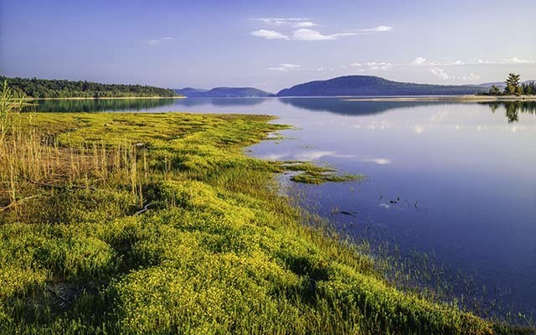
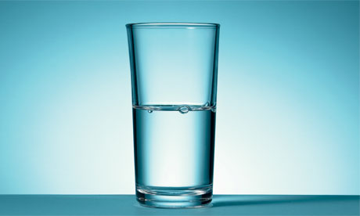
Using the Quabbin Sustainably
As we learned previously in our research on the Quabbin, in order to sustainably and reliably provide the necessary drinking water, the Quabbin cannot be drained below 80% of its capacity of 412 billion gallons of water.
http://www.country-magazine.com/road-trip/east/quabbin-reservoir-wildlife-and-scenic-beauty/
http://laborunionreport.com/wp-content/uploads/2013/11/Half-empty-glass-008.jpg

Slide 10
Each group will be given the volume of the Quabbin at varying levels of capacity collected from the Massachusetts Water Resources Authority’s online data table.

Slide 11
Assignments:
Capacity of Quabbin:
Group 1
Group 2
Group 3
Group 4
Group 5
Group 6
95,172,000,000,000 or 9.5172 x 10¹³ inches cubed (in³)
90,584,340,000,000 in³ or 95.1% of Capacity
84,805,875,000,000 in³ or 89.1% of Capacity
96,326,307,000,000 in³ or 101.2% of Capacity
93,434,418,000,000 in³ or 98.1% of Capacity
82,570,950,000,000 in³ or 86.7% of Capacity
76,137,600,000,000 in³ or 80.0% of Capacity

Slide 12
Math Video!
Now you will watch a video to help you with your calculations.
Notes:
Play attached “Quabbin Volume Math Lesson Final” mp4 file. Sound is low, so play at full volume.

Slide 13
Exit Ticket
Based on the volumes you have been working with during this lesson, do you think the Quabbin will continue to be a source of potable water in the future? You might consider global climate change/drought, population increases, and acid rain.

